Slide 1





GovStack guide to Services Identification, Prioritization & Ranking

Slide 2

Agenda
What is a government service
Service identification
Service prioritization
Service ranking
Validation

Slide 3
What is a Government service

Slide 4
What is a Government service?
Service is the ‘action or process of serving’ or ‘an act of assistance’ or ‘a system providing a public need’
Process consisting of a series of intangible activities that normally, but not necessarily always, takes place in interactions between the provider and consumer
Government is into the business of addressing the needs of citizen through the lifecycle
Governments interact with citizens to provide ‘services’
Every government department provides a set of services to its identified customer base.
The delivery of such services would develop an image of the government among the customers and so making the delivery of services customer-friendly

Slide 5
Service classification
Information services | Transactional services
Provide ‘information’ to customers Does process any transactions / documents Relatively simple back-office operations Can be easily be e-Government-enabled | Customers require specific actions from the provider Requires a higher degree of customer interaction Implies more complex delivery operations than informational services

Slide 6
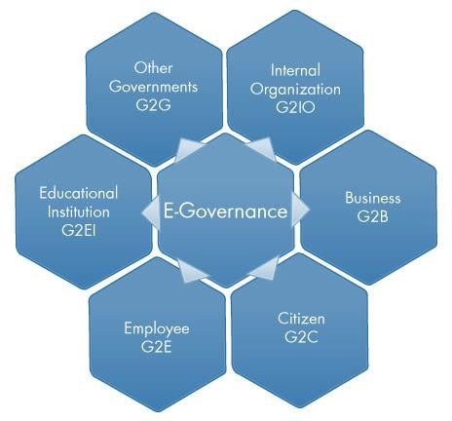
Types of government services

Slide 7
Services identification

Slide 8
Tools & Methods
Target: at minimum 10 government services must be selected per country
Approach: co-design session with country focal points / scoping meetings
Resources:
Digital readiness study
Digital masterplan / roadmap / strategy
Stakeholders input
Tools:
RFI I - II

Slide 9
Recap: main events
1st co-design call: (Date)
Understanding the status quo
Introducing the GovStack approach to digitization
RFI I response: (Date)
10 preselected services: (Date)
2nd country co-design call: (Date)
GovStack approach to Prioritization & Ranking of gov services
Introducing RFI II, III & IV
Prioritization & ranking mission calendar
Ongoing calls to collect responses to RFI II from FPs

Slide 10
GovStack approach to Prioritization & Ranking of Gov Services

Slide 11
Considerations for service prioritization
Needs enabling efforts only to improve the service
Needs transforming efforts also to improve the service
How important is the service - criticality
How valuable is the service to the department / citizen
What is the visibility of the service - numbers affected
How difficult is to digitize the service - complexity
Can the service be digitize - technical feasibility

Slide 12
Collect information & statistics about the services
Collection of various operational information and statistics for the list of services identified, for each service include:
Transaction volumes
Frequency of transactions
Transaction processing time
Number of customer visits
Time spent by the customer for follow-up and track progress

Slide 13


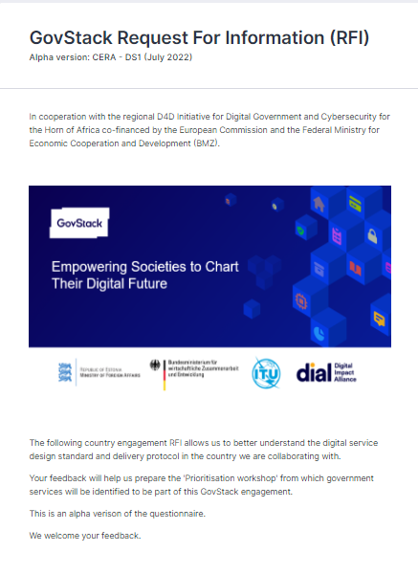
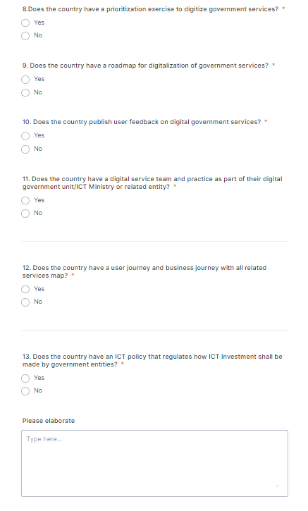
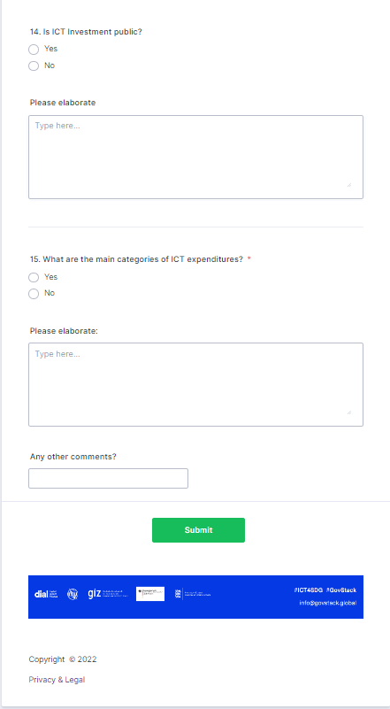
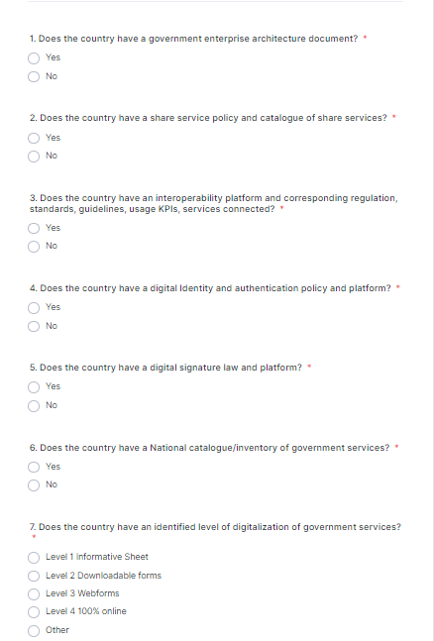
RFI – I
RFI-I allows The Country Team to better understand the Digital Service Design Standard and delivery protocol in the country we are collaborating with.
Notes:
Ayush

Slide 14
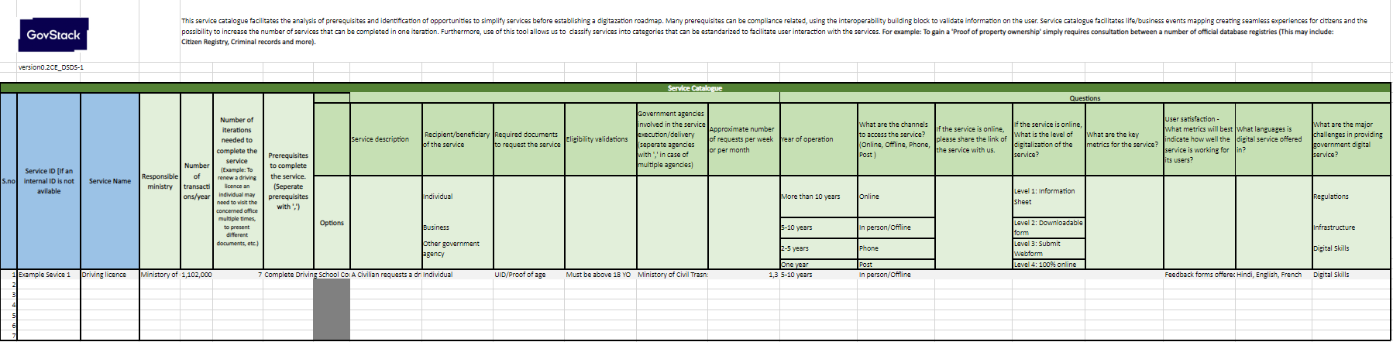
RFI – II
Service Catalogue
Service Catalogue facilitates the analysis of prerequisites and identification of opportunities to simplify services before establishing a digitization roadmap. Many prerequisites can be compliance related, using the interoperability building block to validate information on the user. Service catalogue facilitates life/business events mapping creating seamless experiences for citizens and the possibility to increase the number of services that can be completed in one iteration. Furthermore, use of this tool allows us to classify services into categories that can be standardized to facilitate user interaction with the services. For example: To gain a 'Proof of property ownership' simply requires consultation between a number of official database registries (This may include: Citizen Registry, Criminal records and more).
Notes:
Ayush

Slide 15
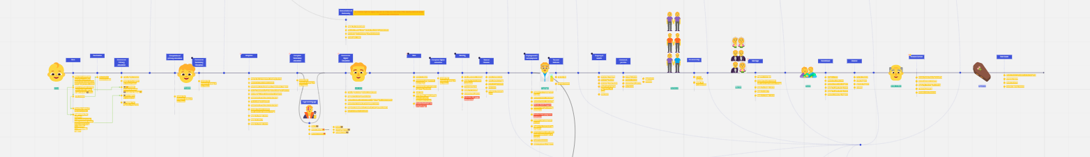
RFI – III User + Business Life Event Board
User + Business Life Event Board allows us to focus on the individual citizen or business. Instead of forcing Users to track down different government agencies in response to a life event such as a birth or death, these agencies collaborate to meet citizen needs proactively. This means anticipating citizens’ needs, sharing information on the citizen’s behalf, and guiding them through their likely next steps. This tool will assist you in:
Identifying the most critical stages in the life of a citizen or a business.
Visualizing the various services the citizen/business may avail.
Identifying the prerequisites to a digital service (Other services, resources, data and more).
Developing services which are seamless, personalized and better integrated.
Notes:
Ayush

Slide 16
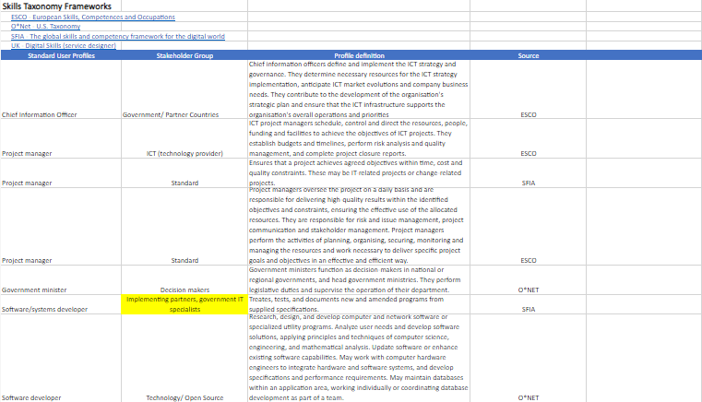
RFI – IV
Skills Taxonomy Framework
Skills Taxonomy Framework
Notes:
Ayush

Slide 17
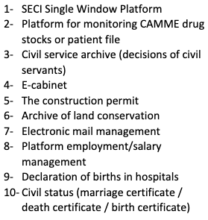
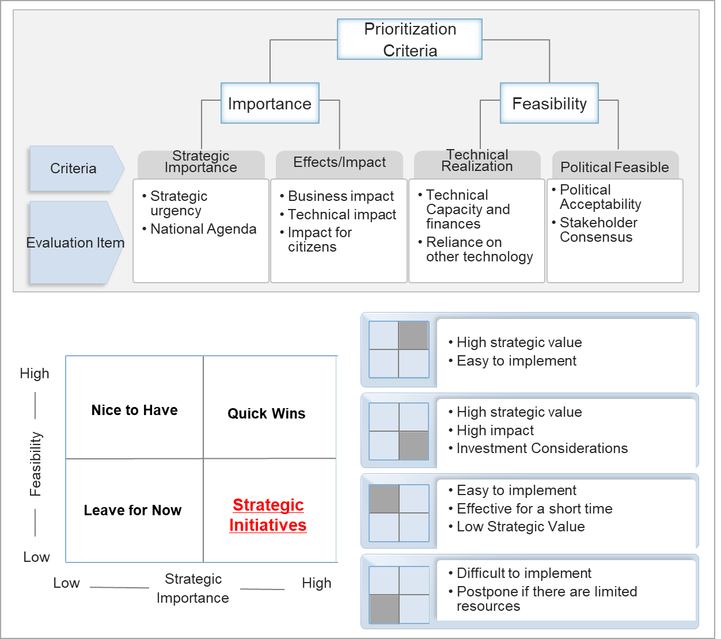
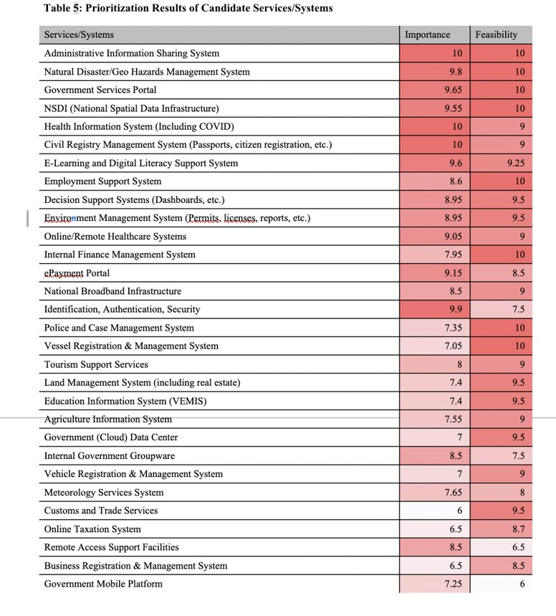
Prioritization and Ranking of Gov Services
Notes:
How does it work?
By mapping out the results of each of the candidate solutions into four (4) quadrants, the solutions can be grouped into different priorities according to the level of feasibility and importance.
The solutions that are both feasible and have strategic importance are considered to be quick wins
The solutions which have high strategic value but low feasibility requires investment and are considered to be strategic initiatives.
Solutions that are easy to implement but have lower strategic value are considered to be in the “nice to have” group
Solutions that have both low feasibility and low strategic importance are considered to be in the “leave for now” group

Slide 18
Prioritization and Ranking of Gov Services Evaluation criteria
Importance | Feasibility
Strategic importance strategic urgency national digital agenda Impact impact for the citizen business impact technical impact Government Impact | Technical feasibility technical capacity financial resources reliance on other technologies Political feasibility political acceptability stakeholder consensus

Slide 19
Prioritization and Ranking of Gov Services –Evaluation criteria
Importance
Criteria | Indicator | RFI input
Strategic importance | Strategic urgency | Number of transactions Customer base Shared services Cross-border service
 | National digital agenda | Alignment with national digital agenda
Impact | Impact for the citizen | Number of iterations (customer visits) Time required for service Time required for follow-up & tracking Time spent by customer on feedback Number of Govt agencies involved Number of prerequisites and documents
 | Government Impact | Environmental footprint (Documents, commutes.)
 | Business impact | Public Private Partnership Attraction of FDI
 | Technical impact | Systems-platforms catalogue

Slide 20
Prioritization and Ranking of Gov Services –Evaluation criteria
Feasibility
Criteria | Indicator | RFI input
Technical feasibility | Technical capacity | Digital skills
 | Financial resources | Degree of existing automation Existing Building Blocks
 | Reliance on other technologies | Existing infrastructure
Political feasibility | Political acceptability | Alignment with national digital agenda
 | Regional harmonization | Data Taxonomy / Semantics Regulatory alignment
 | Digital Transformation authority mandate | Digital transformation mandate
 | Stakeholder consensus | Number of Govt agencies involved

Slide 21
Prioritize the implementation of the high importance / high feasibility services​
Identify when to implement each of the high importance / high feasibility services identified for the department
The implementation priority for each high value service was defined based on the analysis of service importance and service feasibility

Slide 22
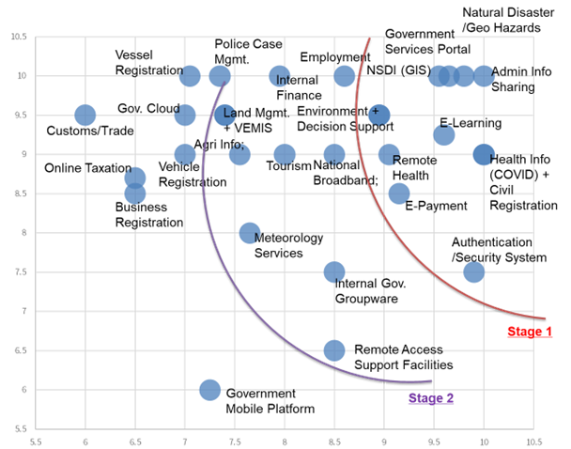
The resulting priorities evaluated for each candidate solution have been mapped to a chart according to the following figure

Slide 23
Validation

Slide 24
Validate and rationalize the results
Validate the identified services / projects for e-Governance through department’s survey, experience and knowledge of the customers
Verify that the high-value services can deliver benefits through digitization
Verify the feasibility of the implementation priorities assigned to the high-value services

